Slide 1
Introduction: Pancasila as a Source of National Character
Session 1
Yustinus Suhardi Ruman
Nikodemus Thomas Martoredjo

Slide 2
Learning Outcomes
Describe the Pancasila as the major basis for character education, worldview of Nation and the ideological foundation of Indonesian state

Slide 3
The Importance of Character Education
In the college, character education emphasizes the using of freedom aspect.
It is important to help students gain an adequate understanding and being able to use their freedom of choice in a morally justified action.
The form of character education in college that is doing the study, critical reflection and systematic (a discussion of the cases related to the issue of character).
Perform activities related to the appreciation of the values that increasingly influence the attitudes and actions.

Slide 4
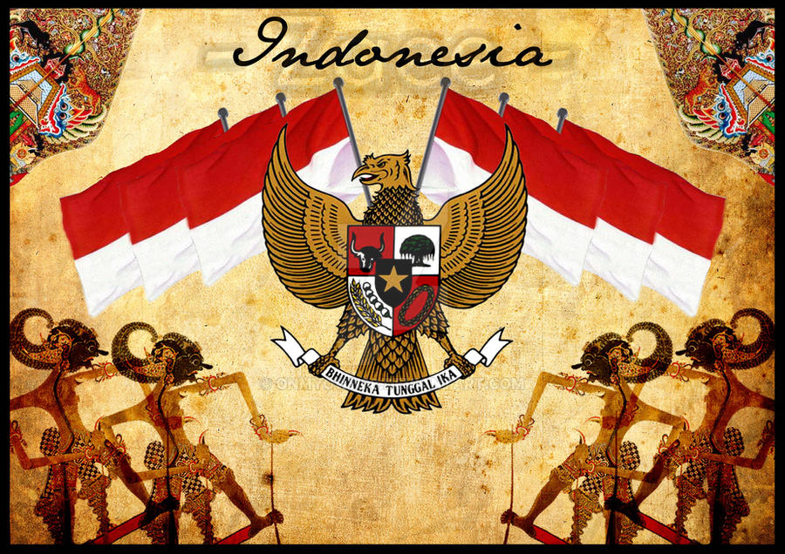
Pancasila as a Source of Character Education
Pancasila is the main source of education and development of civic character.
Pancasila consists of five basic values, namely divinity, humanity, unity, democracy (consultation), social justice.
The five basic values are the nation's view of life
This Photo by Unknown Author is licensed under CC BY-NC-ND

Slide 5
Learning Topics and Outcomes
Session | Topics | Learning Outcomes
1 | Introduction: Pancasila as a Source of National Character | Describe the Pancasila as the major basis for character education, worldview of Nation and the ideological foundation of Indonesian state
2 | The History of Pancasila | Describe the Pancasila as the major basis for character education, worldview of Nation and the ideological foundation of Indonesian state
3 | Pancasila as the Worldview of the Nation | Describe the Pancasila as the major basis for character education, worldview of Nation and the ideological foundation of Indonesian state
4 | Belief in the Supreme Divinity | Solve the social issues related to Values of Pancasila
5 | Justice and Civilized Humanity | Solve the social issues related to Values of Pancasila
6 | The Unity of Indonesia | Solve the social issues related to Values of Pancasila
7 | Culture Interaction | Solve the social issues related to Values of Pancasila
8 | Pancasila Democracy | Solve the social issues related to Values of Pancasila
9 | Pancasila Leadership | Solve the social issues related to Values of Pancasila
10 | Social Justice | Solve the social issues related to Values of Pancasila
11 | Pancasila as Basic Ethics for Science and Technology | Compose reflections on developing science and technology with Pancasila as the ethical basis and the implementation of Pancasila
12 | Pancasila and Anti-Corruption Character | Compose reflections on developing science and technology with Pancasila as the ethical basis and the implementation of Pancasila
13 | Implementation of Pancasila | Design a project related to Pancasila Values

Slide 6
Closing
Q & A
Thank you.

